Slide 1
Week 3
CUA REU
Nuclear Physics
Richard Lara

Slide 2
Weekly Progress
This week I have officially finished the calibration of the drift chambers and uploaded the Drift Chamber calibration data to Dr. Yero’s GitHub repository
Further reading Dr. Yero’s thesis
Reading documentation about the procedure for the calibration of drift chambers
Reading Nuclear & Elementary Particle Physics textbooks
Goal: Familiarize myself with introductory Nuclear Physics terminology and concepts

Slide 3
Drift Chamber’s Planes
Radiation hardening: process of making electronic components and circuits resistant to radiation damage
Material commonly used:
Lead Glass and Leaded Polymers
Tungsten
Metal alloys
Drift Chamber Planes:
Aluminum frames used for radiation shielding (lightweight material)
SHMS and HMS have Copper-Plated Beryllium field wires
SHMS: 80μm HMS: 100μm
Both SHMS and HMS have 20μm gold-plated tungsten sense wires

Slide 4
Field Wires: Kept at a negative potential (~-1940V) relative to the zero potential maintained by sense wires → potential difference establishes an electric field
Properties of Copper Plating:
Excellent conductor of electricity; ease of plating onto beryllium; provides some level of protection against corrosion and oxidation
Properties of Beryllium:
Low density (1.85Mg/m^3); High stiffness; Good thermal conductivity; relatively transparent to forms of radiation → minimizes interference in particle detection
Combined:
Beryllium’s good radiation tolerance makes wires less likely to suffer radiation damage.
Beryllium and copper thermal conductivity reduces the risk of overheating
Sense Wires: An anode wire in multiwire chambers on which the avalanche of electrons is collected
Properties of Gold Plating:
Highly resistant to corrosion and oxidation; excellent conductor of electricity
Properties of Tungsten:
High density [19.28g/cm^3]→ excellent for radiation shielding
High Melting point [3,422 C]; High Durability
Combined: Durable material that maintains its properties over time
Gold plating prevents tungsten from corroding, while tungsten provides effective radiation shielding
Excellent electrical conductivity of gold combined with the structural properties of tungsten

Slide 5
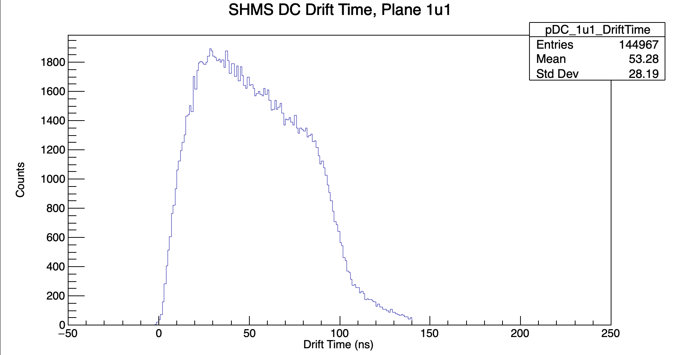
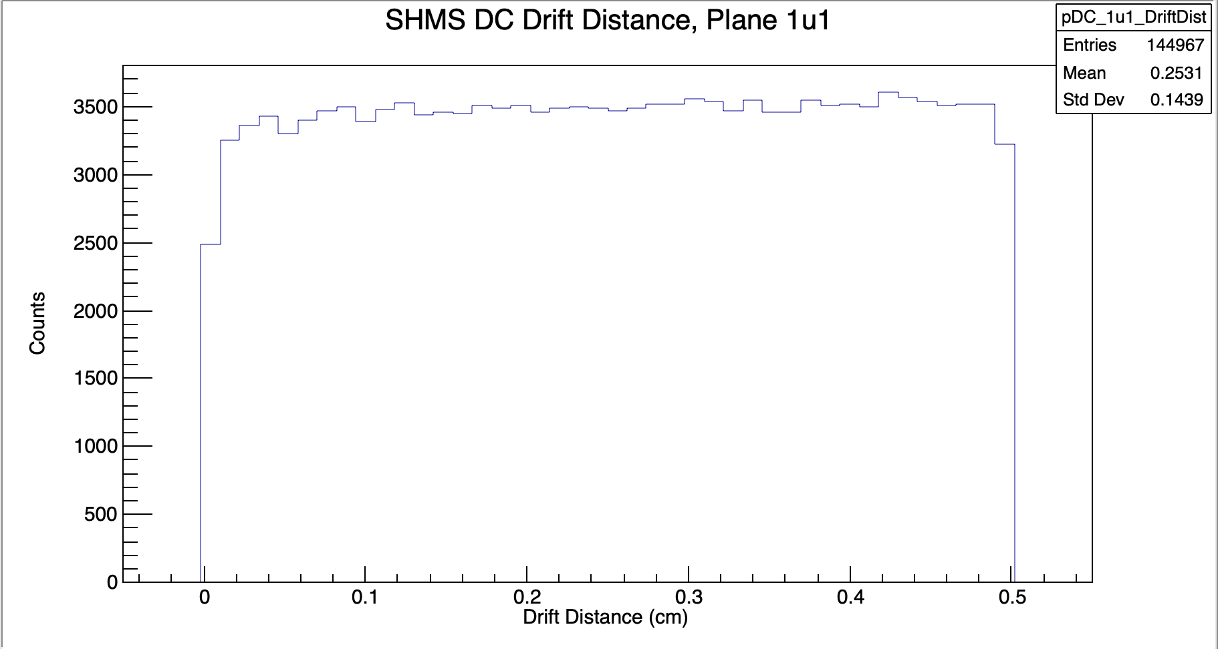
How are the drift times converted to drift distances?
?
Drift distance: refers to how far the path of particle was from the sense wire fired
Afterwords, the collection of sense wire hits are fitted in each drift chamber, and the best chi^2-fit is chosen as the best reconstructed trajectory

Slide 6
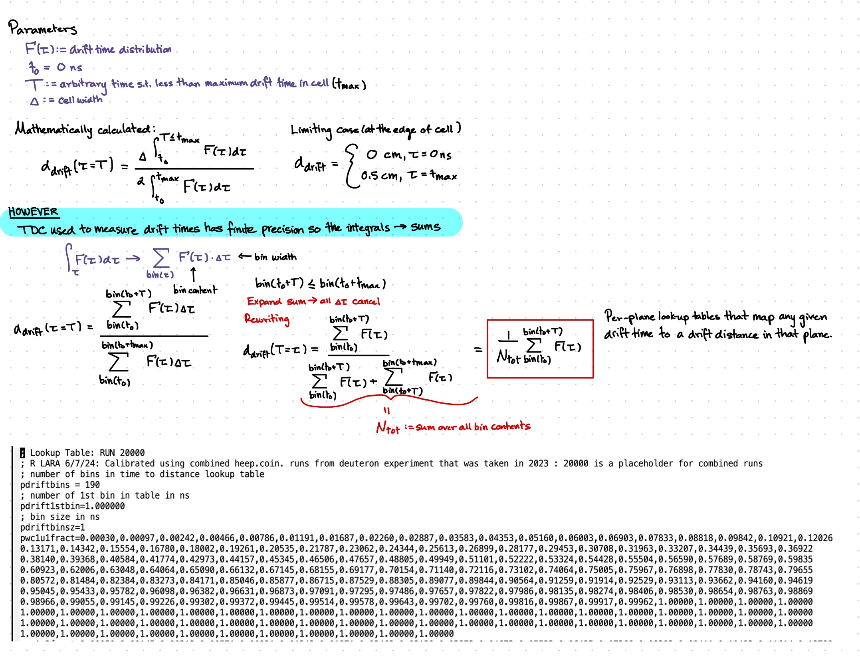

Slide 7
Next Week
Goal: Reread and continue reading to get a better understanding of Nuclear Physics and functions of the SHMS and HMS components
Tour of Hall C
Start working on phase 2 of my project

